Slide 1

Title 1: Mobile Robot-Drone Co-operation for Efficient Path Planning
Title 2: Integrating Aerial Images from a Drone to Enhance Autonomous Robot Navigation
Under the Guidance of
Prof. Shivashankar B. Nair
Deepak Yadav (234156003)
M.Tech CICPS
Dhaval Parmar (234156004)
M.Tech CICPS

Slide 2
Outline
Introduction
DGA-Star
Gound robot
Drone Flight
System Architecture
Simulation
Image Processing
Results
Conclusion - Future Work
Paper Submission

Slide 3

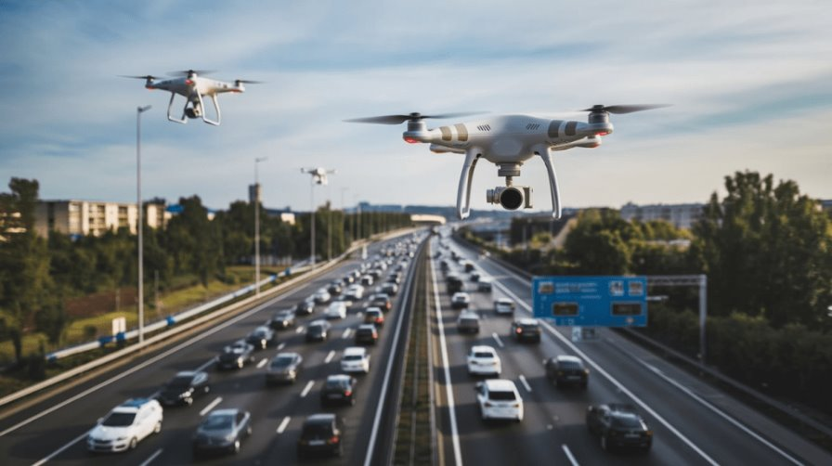
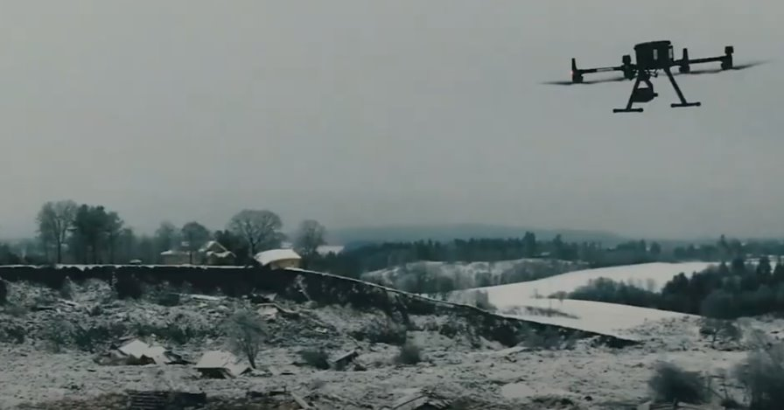
Introduction

Slide 4
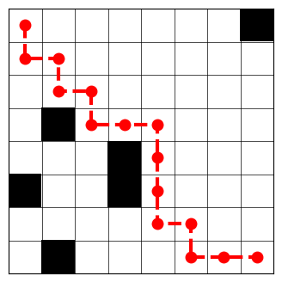
A-Star
Branching Factor
Depth of Tree
Time complexity : Branching ^ Depth

Slide 5
Data Structures of DGA-Star
Grid Initialization
Division of Cell
Each grid cell includes:
Coordinates and Size
Obstacle Flag
Adjacency List

Slide 6
DGA-Star Algorithm
1. Start Check
2. Goal Check
3. Search Loop:
Runs Adjacency A-Star
If path is found, return the path
If no path is found, further split the obstructed cells and retry.

Slide 7
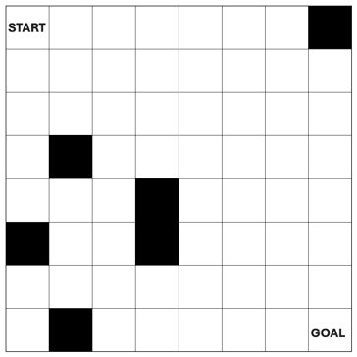
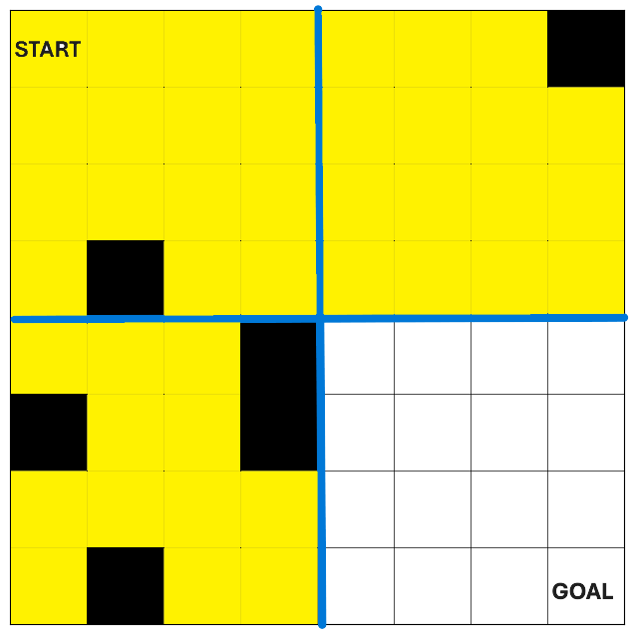
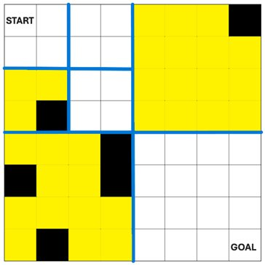
Node-Splitting Visualization

Slide 8
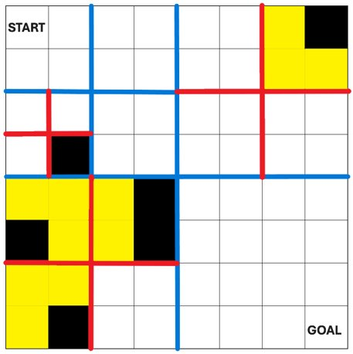

Traced Path From START to GOAL

Slide 9
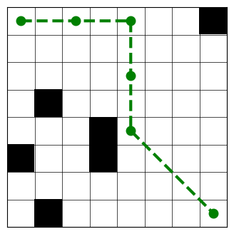
DGA-Star VS A-Star

Slide 10
Comparative Study
DGA-Star (Dynamic Grid A-Star)
Adapts grid resolution based on obstacle density
Balances accuracy and computation by refining only cluttered regions
A-Star (A*)
Best performance in static environments.
Balances speed and optimality using heuristics
D-Star (Dynamic A-Star)
Designed for real-time replanning in dynamic environments
Continuously updates path when obstacles change or move.

Slide 11
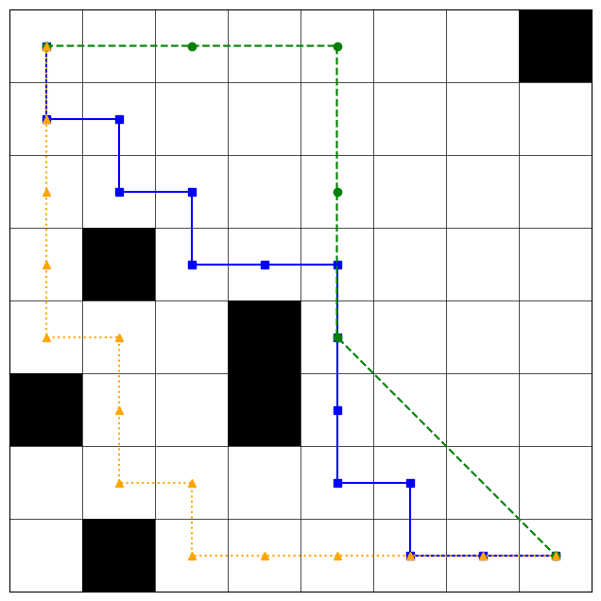
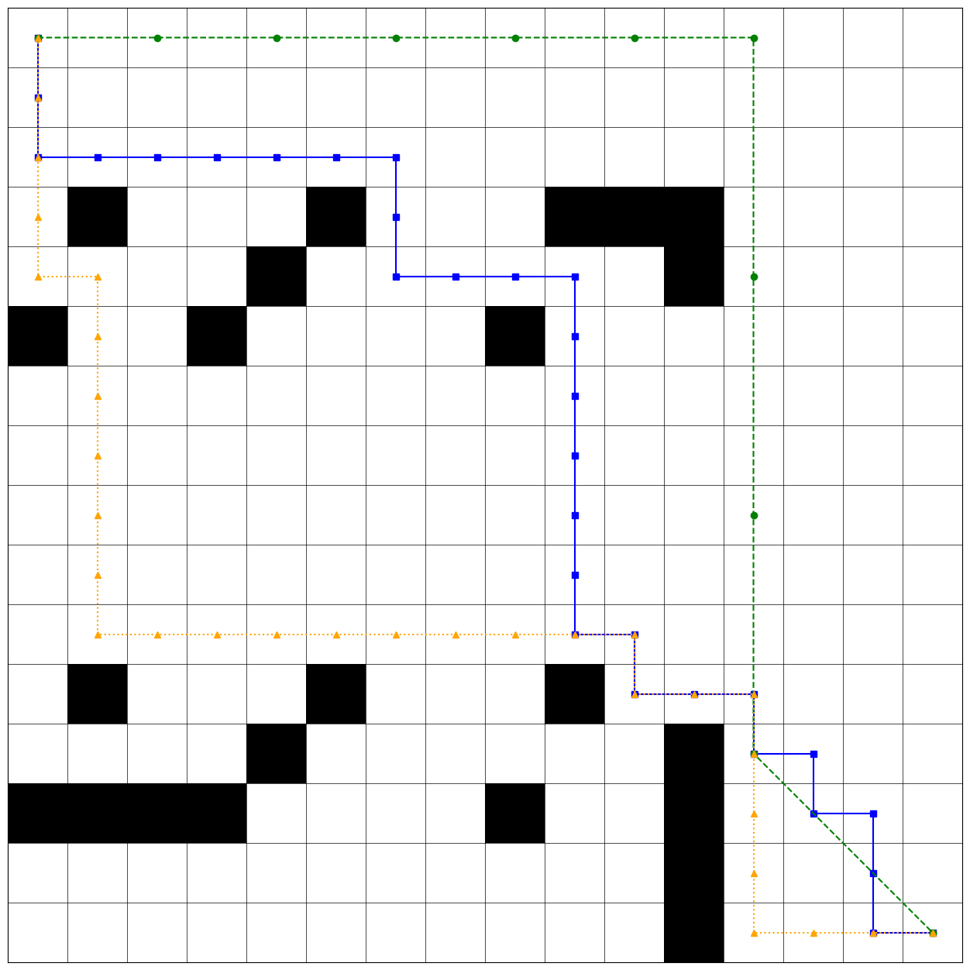
Qualitative Comparison between DGA-Star(Green), A-Star(Blue) and D-Star (Yellow)

Slide 12
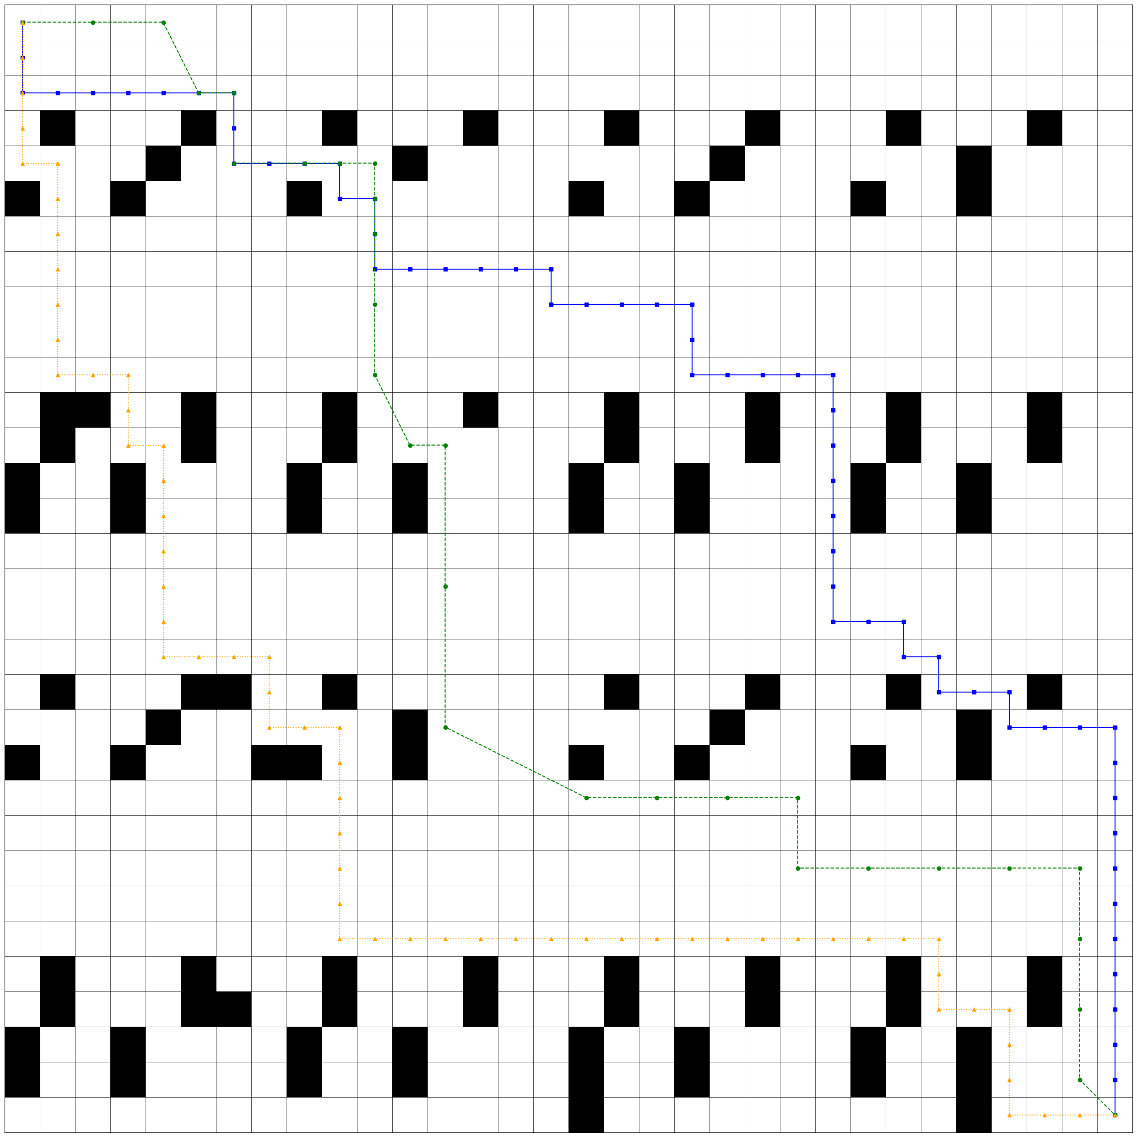
Path Comparision

Slide 13
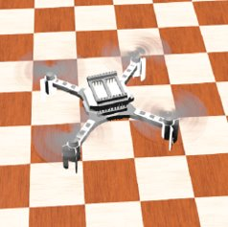
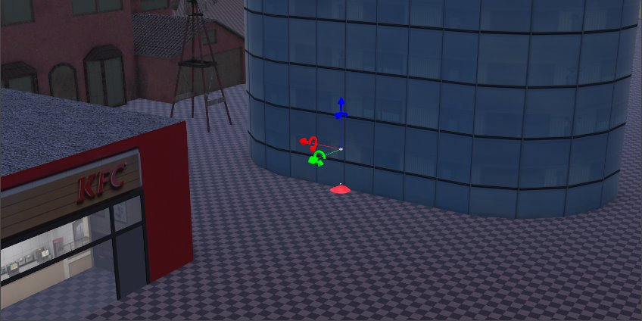
Drone Flight
PID Controller
Camera
Emitter
GPS

Slide 14
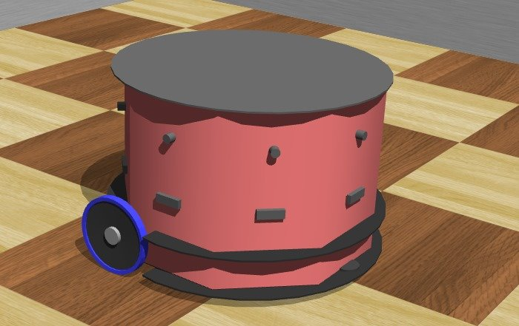
Ground Robot
Compass
GPS
Receiver

Slide 15
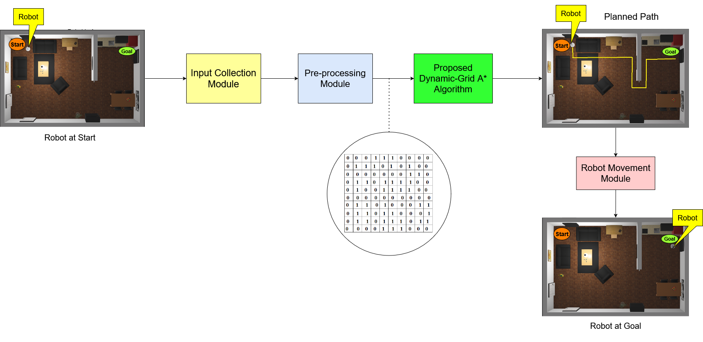
System Architecture

Slide 16
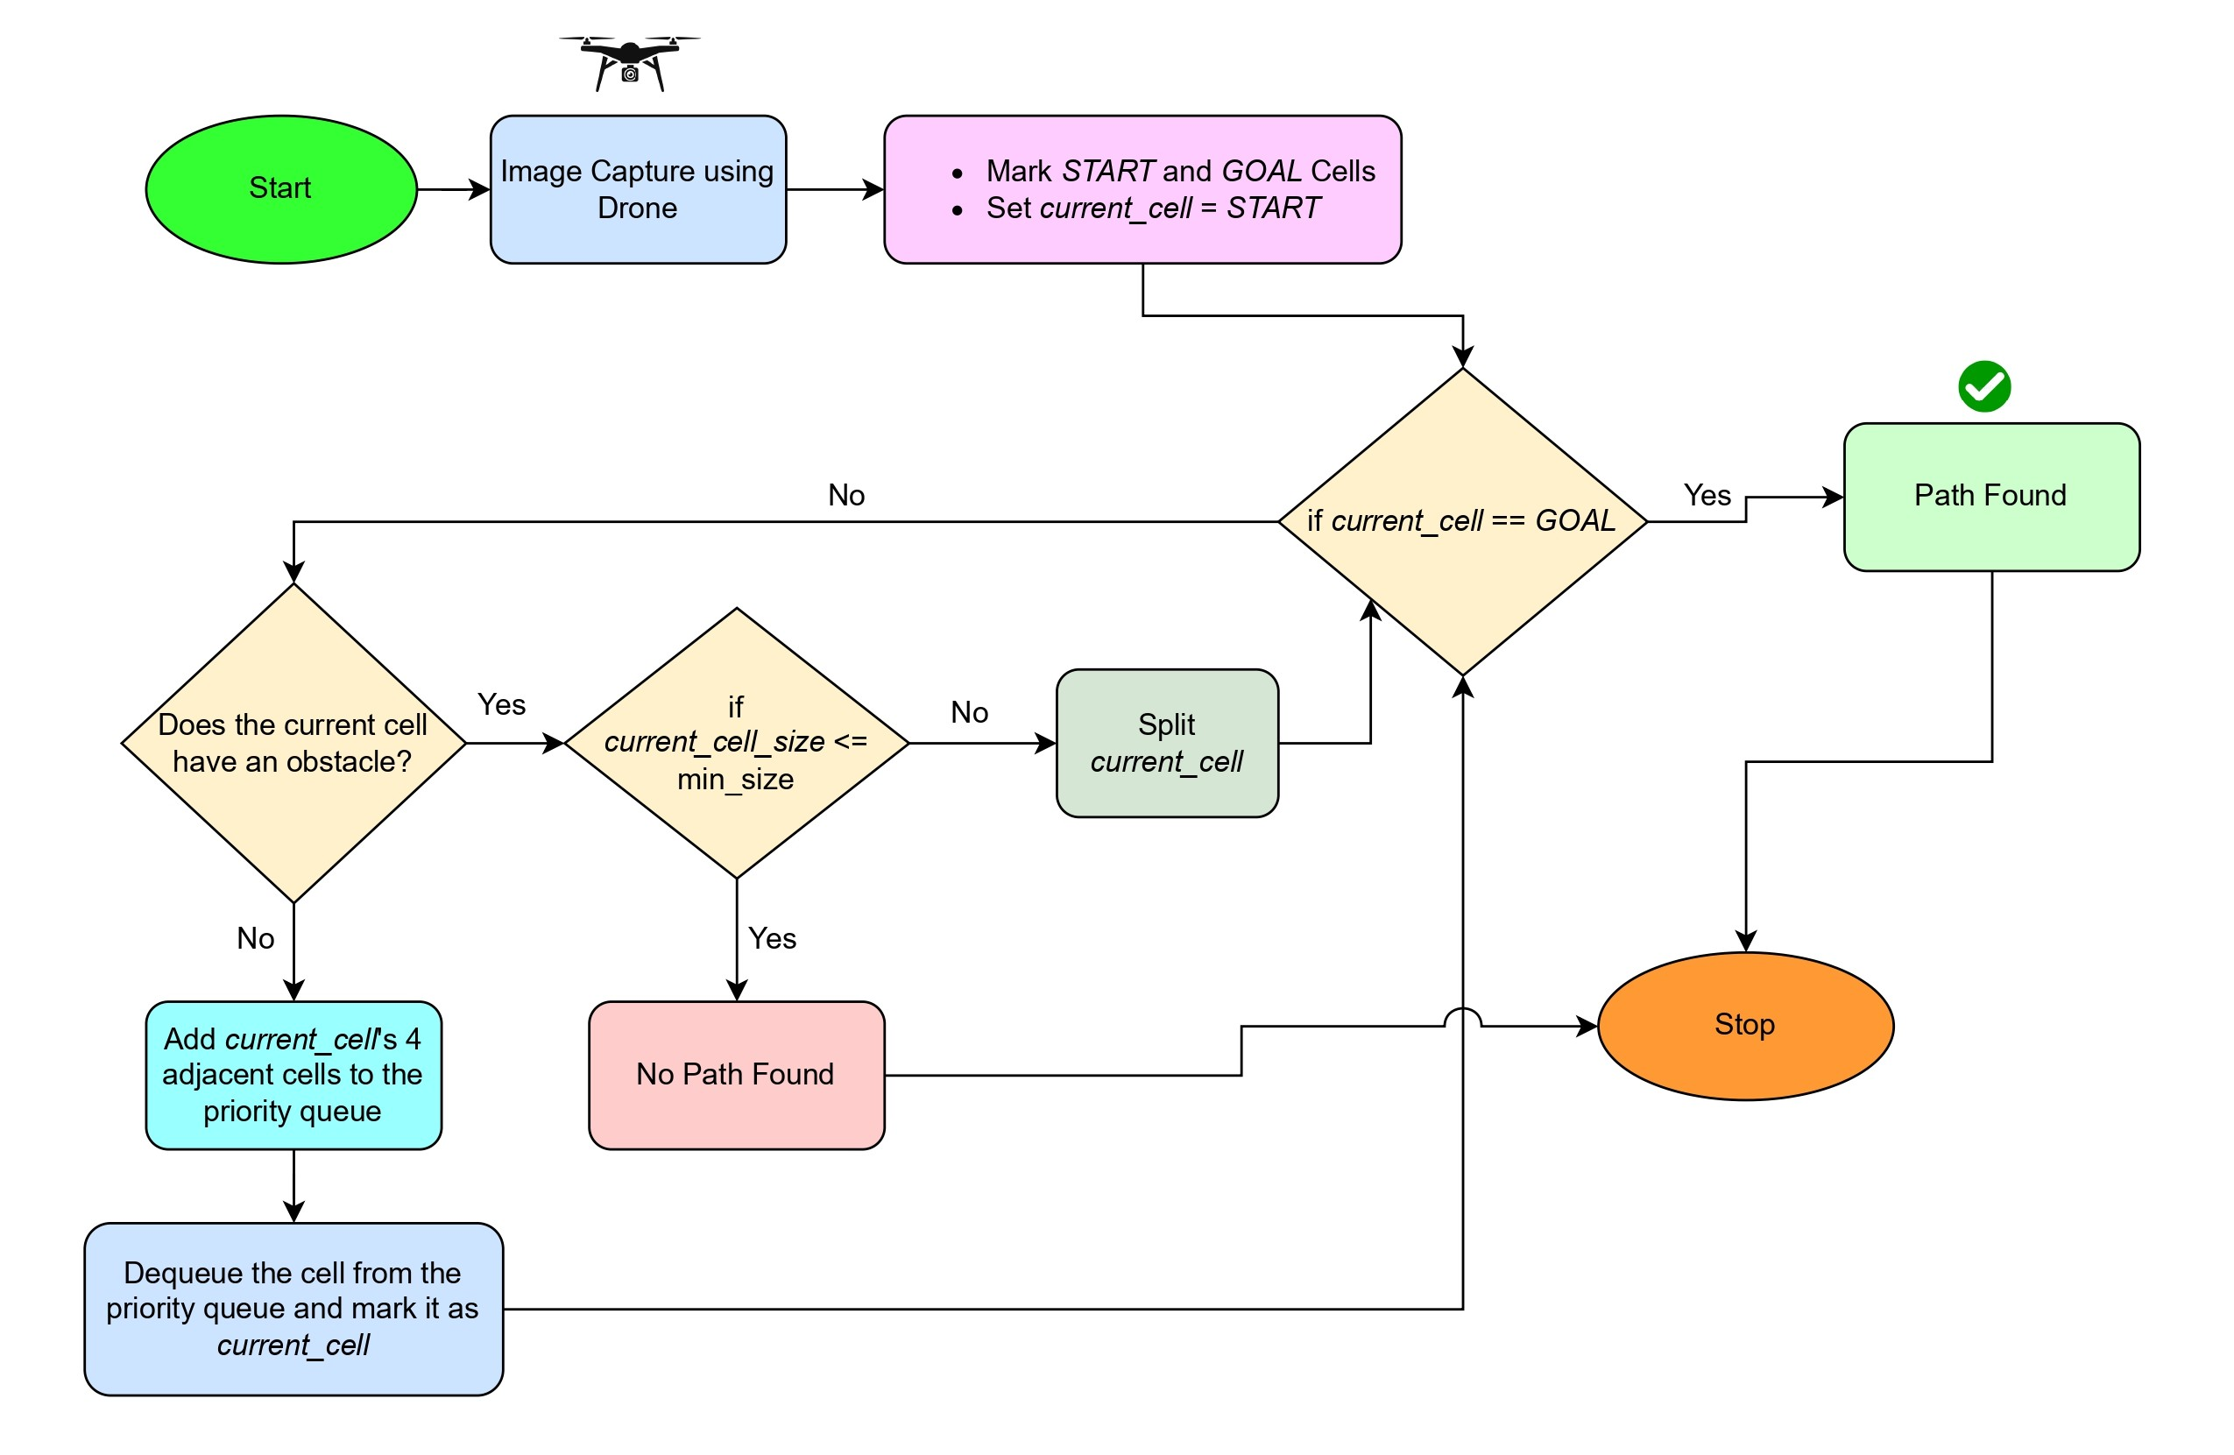
Workflow

Slide 17
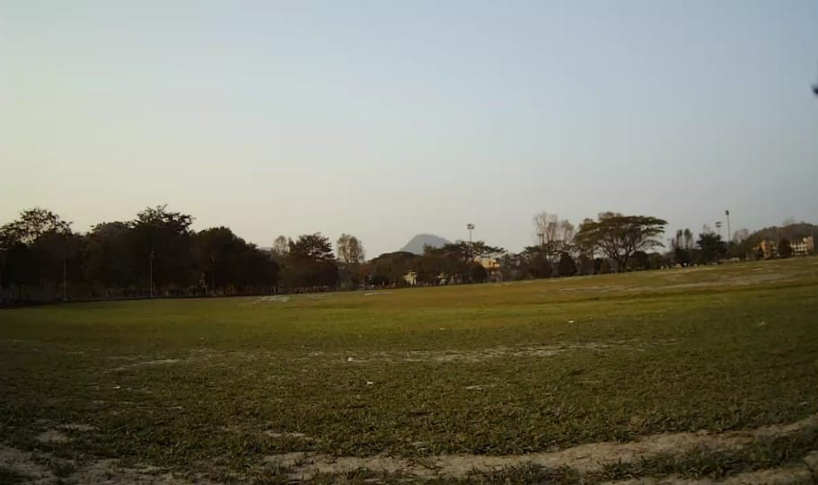
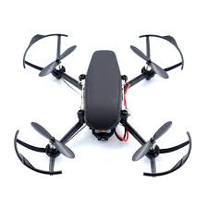
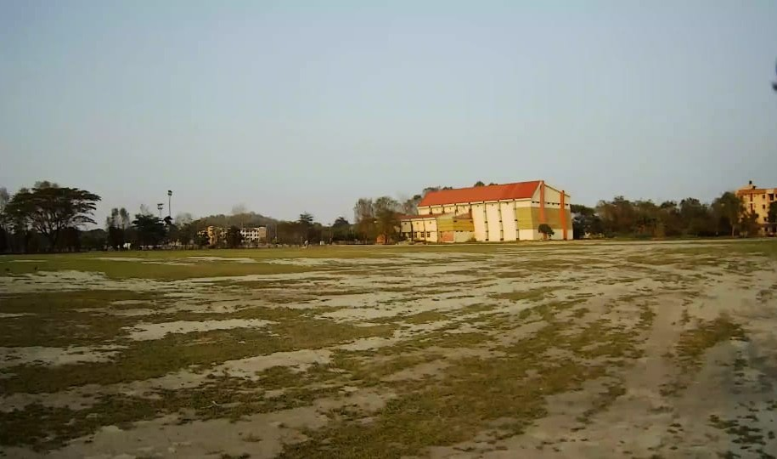
PlutoX Drone Images

Slide 18
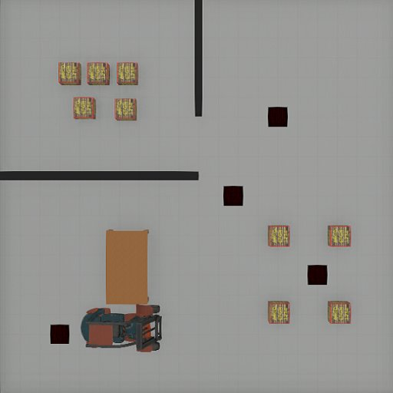
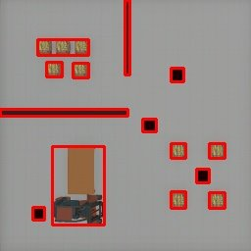

Image processing
(a)
(b)
(c)
Original Image
Obstacle Contours
Binary Image

Slide 19
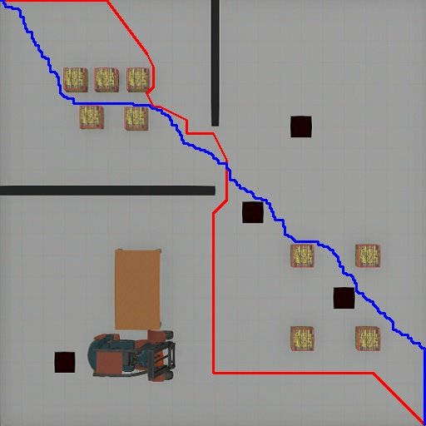
Path Traced by DGA-Star (Red) and A-Star (Blue) algorithm from Top Left corner to Bottom Right Corner.

Slide 20
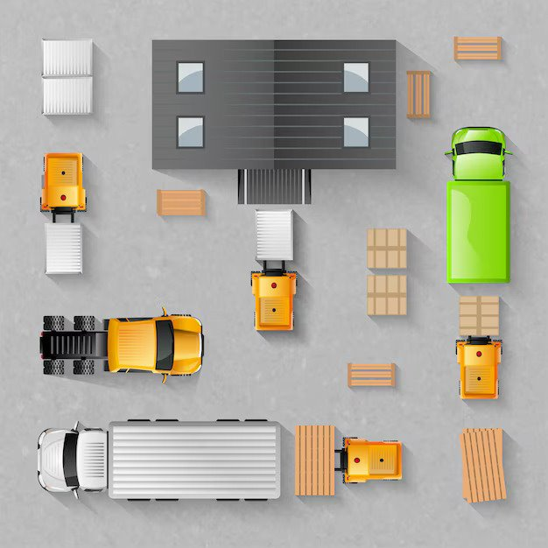
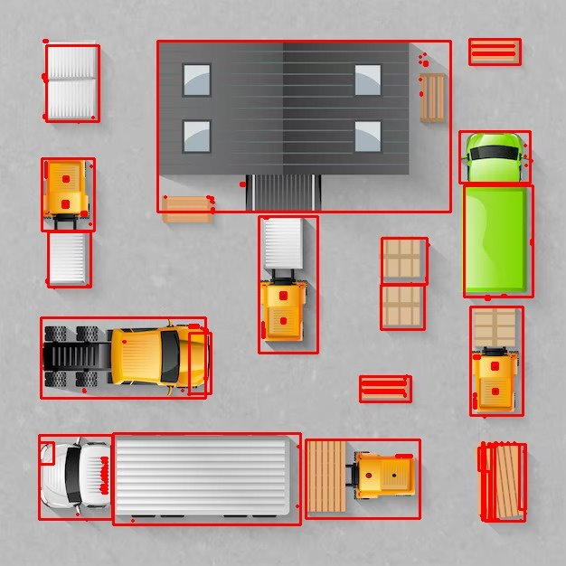

Image Processing
(a)
(b)
(c)
Original Image
Obstacle Contours
Binary Image

Slide 21
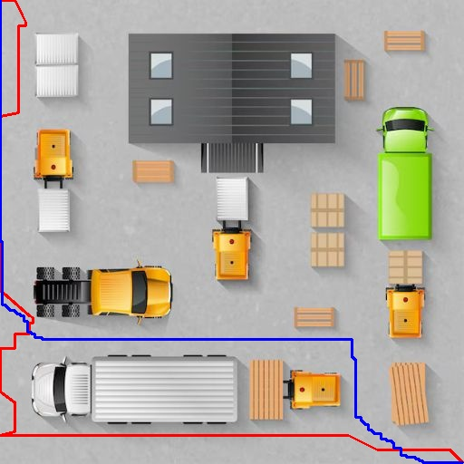
Path Traced by DGA-Star (Red) and A-Star (Blue) algorithm from Top Left corner to Bottom Right Corner.

Slide 22
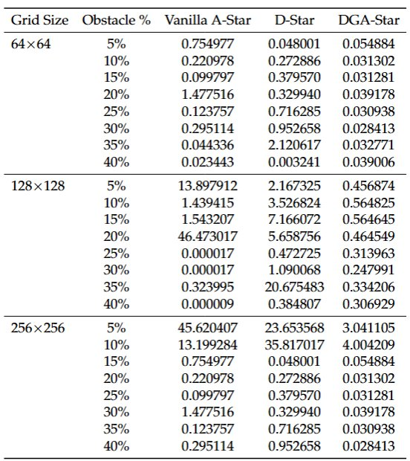
Result:
Analysis of Computational time

Slide 23
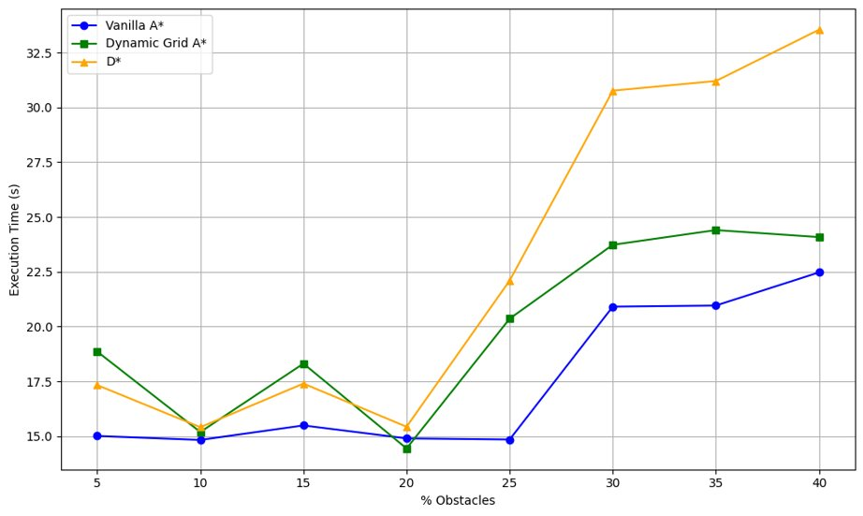
Run-Time Comparison in Webots

Slide 24
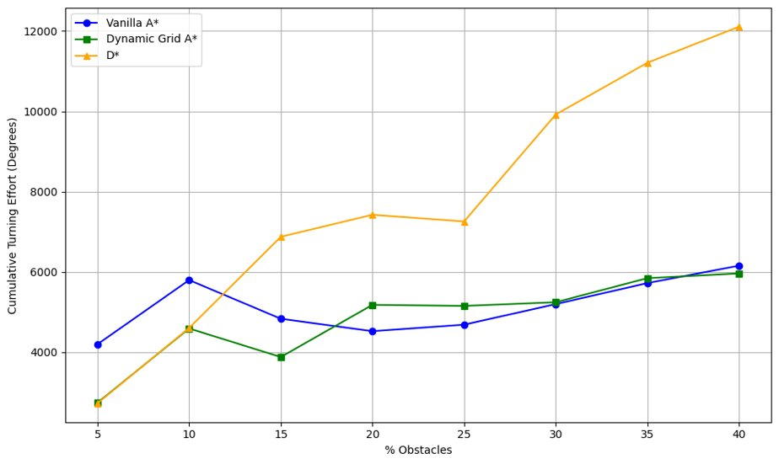
Cumulative Turning Effort VS Obstacle Density

Slide 25
Conclusion
Enhanced Path Smoothness
Reduced Energy Consumption
Decreased Mechanical Wear and Tear

Slide 26
Future Works
Multi-Agent Coordination
Enhanced Algorithm Efficiency
Dynamic Obstacle Handling
Video Integration

Slide 27

Paper Submission
Deepak Yadav, Dhaval Parmar, Gayathri Rangu, Shivashankar B. Nair, ”Enhancing Mobile Robot Path Planning using Aerial Information from Drones”*, 10th European Conference on Mobile Robotics(ECMR), 2025, Italy.

Slide 28
Thank You

